Slide 1
Stellar Wings
A Virtual Reality experience
Brandon Huzil
Viktor Fries
Lukas Hoffman
Jared Thompson

Slide 2
What is Stellar wings
Stellar wings is Virtual Reality space based dog fighter where players take control of a powerful stellar space fighter and collect resources and do battle with raiding enemy ships.

Slide 3
The Design
We recognized that we could split the project into 4 sections that could be concurrently worked on by each member of the group.
Viktor – The Ship
Brandon – The Environment
Jared – The Weapons
Lukas – The Enemies

Slide 4
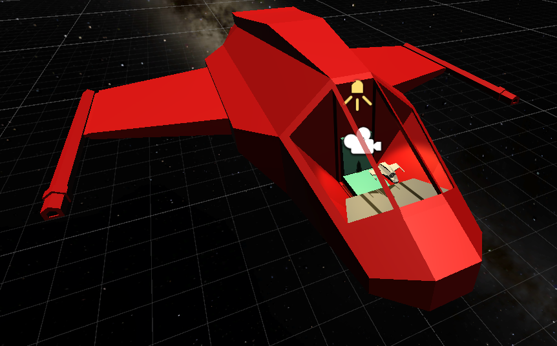
The Ship
The only constant point of reference for the player.
Modified existing asset from https://mehrasaur.itch.io/3d-spaceships-pack

Slide 5
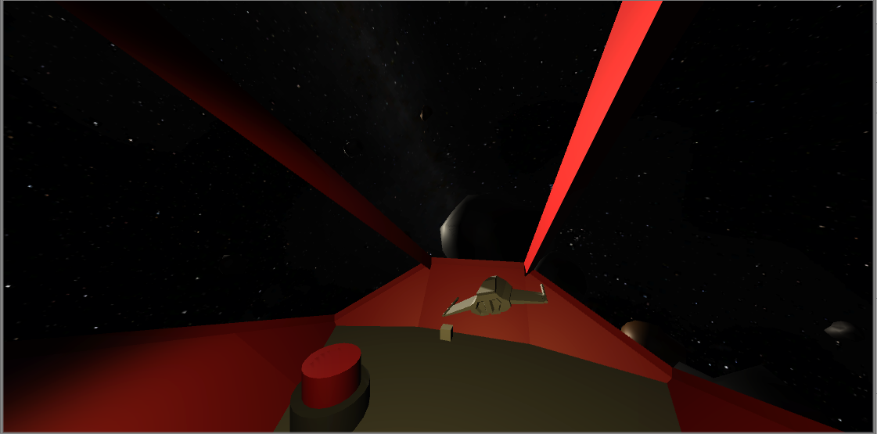
The Cockpit
Parallel beams to reduce simulator sickness
Array of buttons too perform specific tasks
Steering accomplished by moving model of ship relative to an origin point

Slide 6
The Environment
How do you populate a space environment you ask?
Asteroids!
We realized that in order to create an interesting and varied landscape or in this case, spacescape we needed to use asteroids that varied in size, shape, and colour.
Then these asteroids could be put in large formations such as asteroid fields and asteroid belts.
Its time for procedural generation.

Slide 7
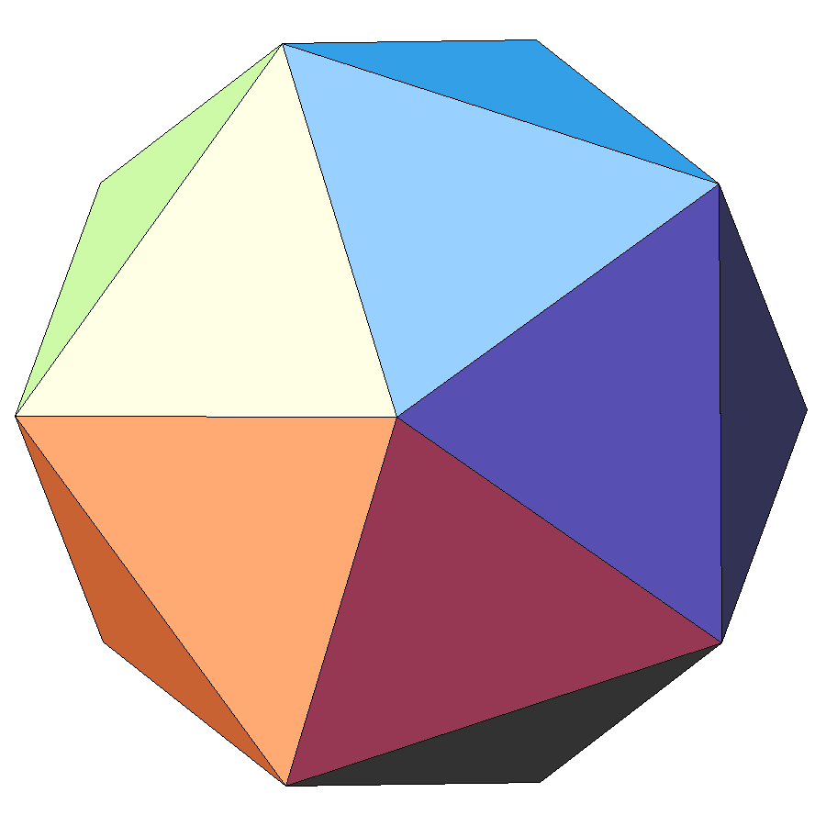
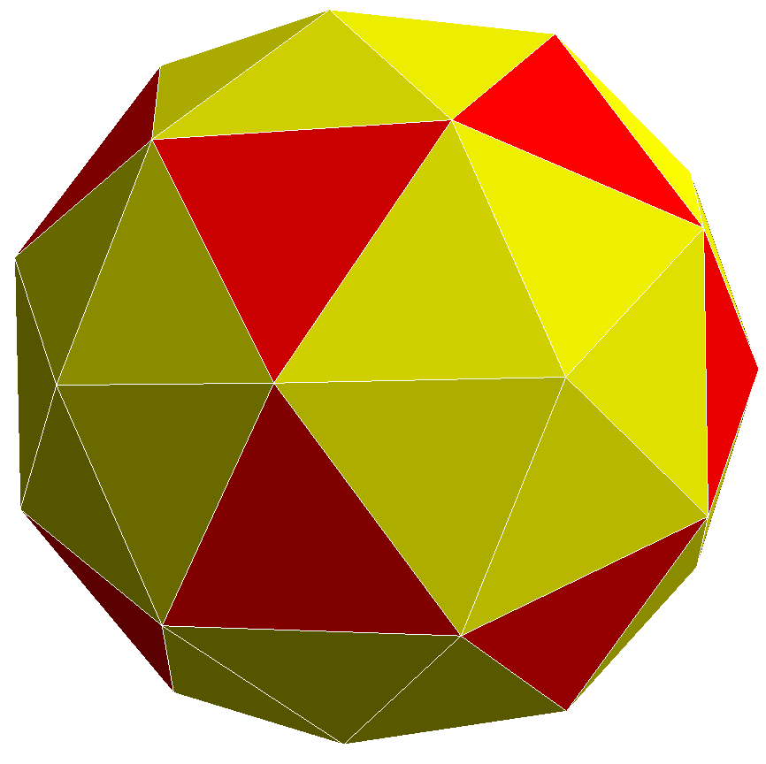
Procedural Asteroids… HOW?
Lets morph the positions of vertices on sphere meshes to achieve asteroid shapes, but any old sphere type wont do.
This is an icosahedron, a 20 sided shape of uniform faces and edges that geometry can help us build.
We can refine an icosahedron by dividing each triangular face into 4 new triangular faces, we call the resulting shape an icosphere.
https://upload.wikimedia.org/wikipedia/commons/e/e8/Zeroth_stellation_of_icosahedron.png
https://upload.wikimedia.org/wikipedia/commons/a/a9/Pentakis_icosidodecahedron.png

Slide 8
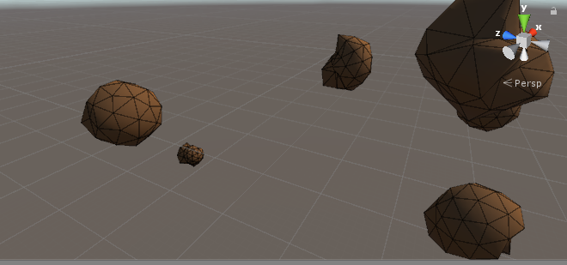
Asteroids as morphed Icospheres
We can add slight randomness into the icosahedrons geometry to start.
Then we can refine it into an icoshpere.
Last we can take random amounts of 3 vertices corresponding to a triangular face and project them in or out from the shapes center.
Asteroids break into smaller asteroids when destroyed.

Slide 9
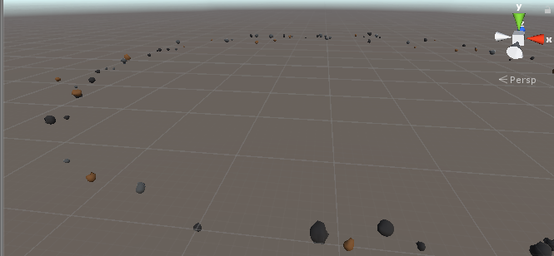
Asteroid behaviour
We can group our procedural asteroids together to behave as a collective body, asteroid fields and asteroid belts.

Slide 10
Now to fill our “spacescape”
We need to fill places the player has been and is near with asteroid groups that wont change but we need to save on computations too.
Imagine space subdivided into massive blocks like and infinity by infinity by infinity Rubik's cube.
These blocks can correspond with a 3 number coordinate.
If players approaches a never encountered block of space, fill it with asteroid groups, leaving the infinite amount of blocks the player hasn't been to empty and computation free.

Slide 11
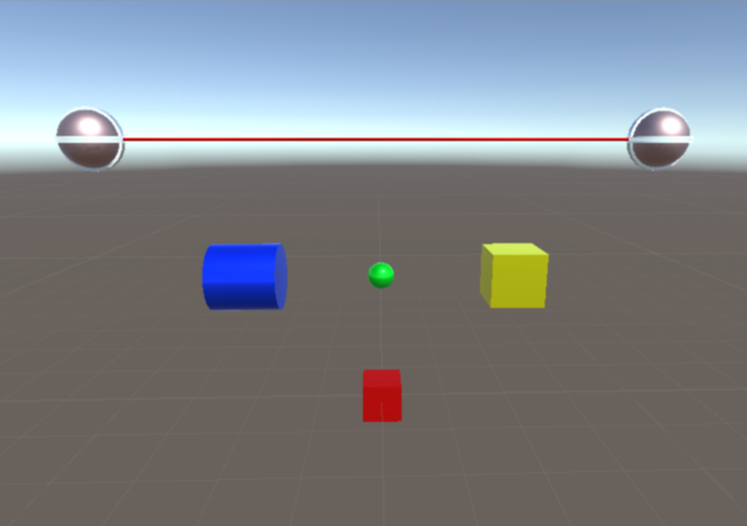
The Weapons
Four Kinds of Projectiles
Bullets: Average stats, fast reload
Rockets: Slow but powerful, decent reload
Shrapnel: Weak but fires multiple rounds in a scatter shot formation
Laser: Strongest weapon, wide range, but slow with longest reload
Player fires projectiles using triggers, changes using buttons
Enemies uses a bullet variant, slightly slower

Slide 12
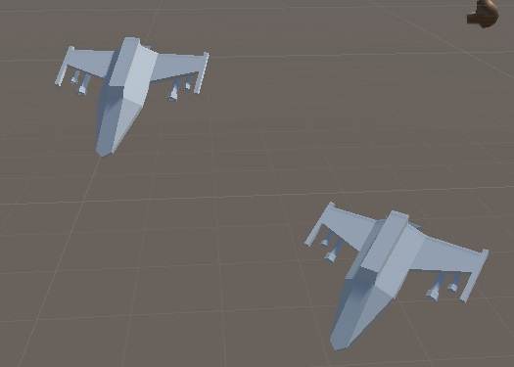
Enemy Models
Free low-poly assets
Modeled in Blender
Modeled in Blender
Clay models (no mats or uv mapping)
https://mehrasaur.itch.io/3d-spaceships-pack

Slide 13
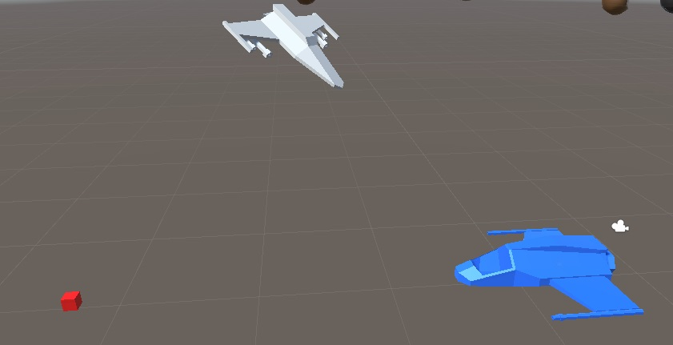
Movement
Transform.lookat(target)
Switches it’s “lookat” target depending on the distance from the enemy
Accelerate toward target
Fire weapon when in range

Slide 14
Enemy Spawner
GameObject player = FindWithTag(“player”)
Vector3 spawnPosition = Random.onUnitSphere * playerRadius + player.transform.position
enemy[i].transform.position = spawnPosition

Slide 15
Enemy Stats
Each enemy has their own stats script
Contains their current health and damage numbers
Spawner keeps track of the starting base stats
Scales stats up after x amount of time
New enemies spawned have higher stats

Slide 16
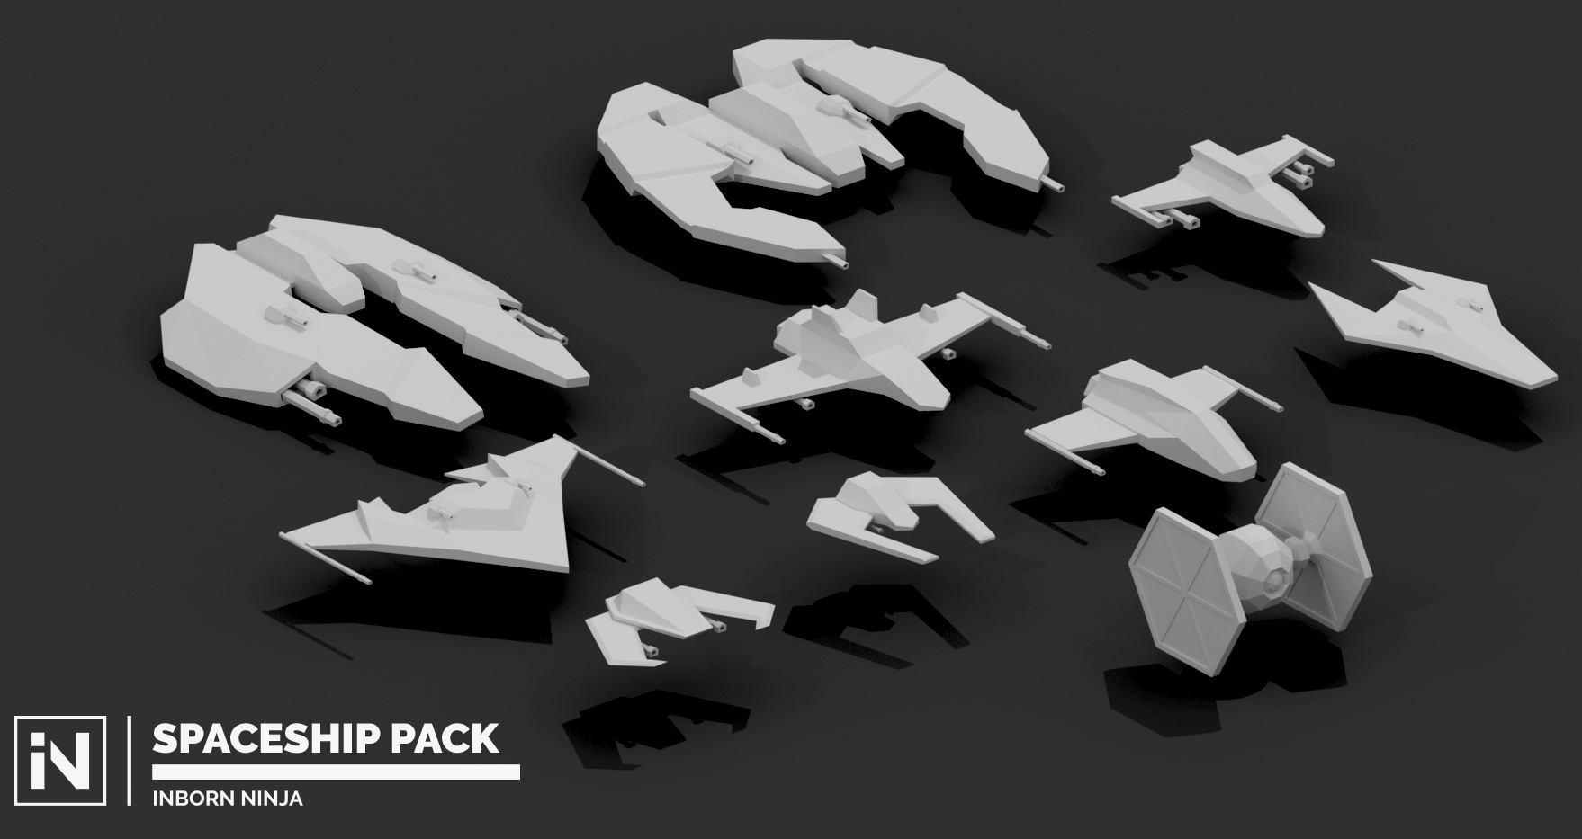
Enemy Ships

Slide 17
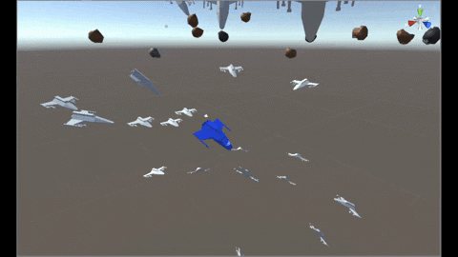

Slide 18
Stellar Wings In Action

Slide 19
Thanks for listening to our presentation
Any Questions?

